Slide 1
KnowledgeShare
Team Harambae
Karen Cudjoe, Andrew Darmawan, Cameron Dewey, Andrew Gbeddy, Corey Noble

Slide 2
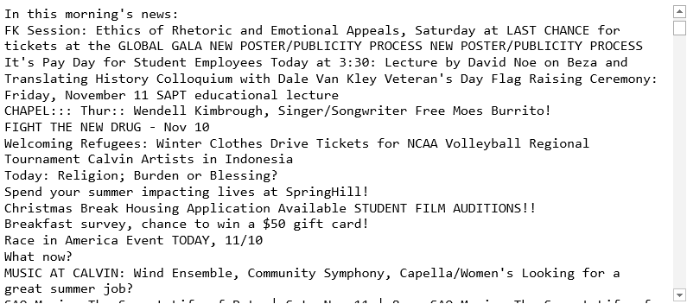
What Students Are Stuck With

Slide 3
Vision
Enhance existing Student News
Current Student News…
Card-based dashboard
Search
Filters

Slide 4
Key User Stories
As a Calvin student, I would like to be able to view student news on an app that has a simple and easy-to-use design
As a Calvin student, I want to be able to search for specific news stories
As a student org member, I want to be able to see news items specific to my student org
As a student looking for a job, I want to be able to see news items from the career center about job opportunities

Slide 5
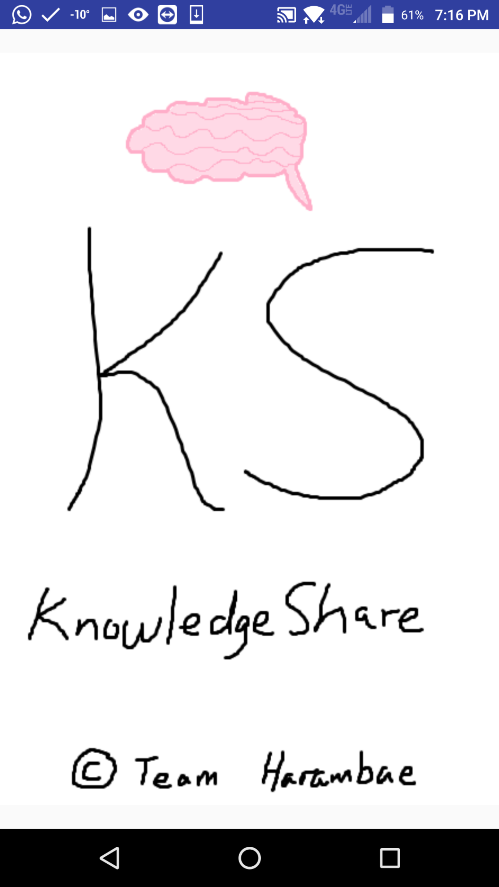
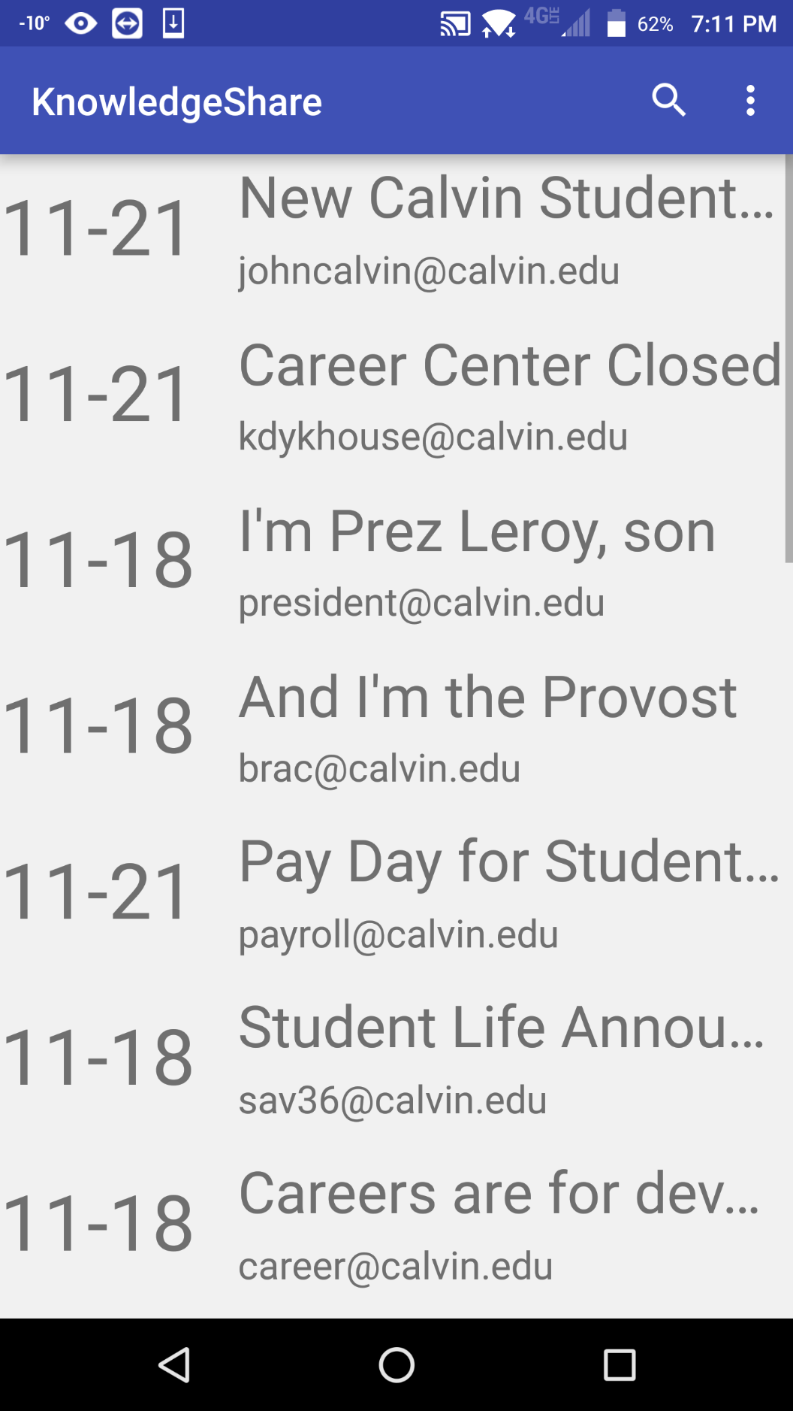
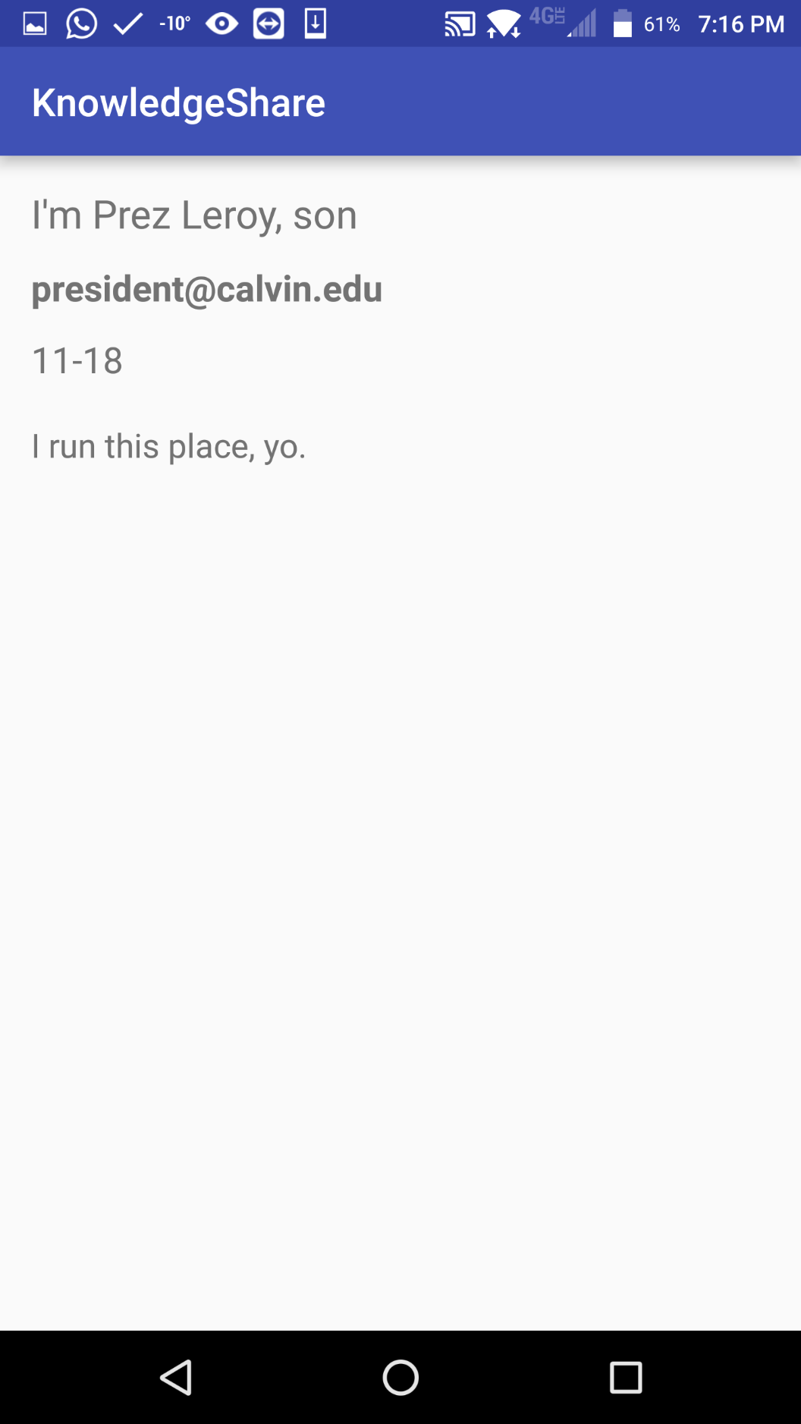

Slide 6
Usability Test Feedback
Cards do not look clickable
Unnecessarily LARGE fonts
Boring home screen

Slide 7
Demonstration

Slide 8
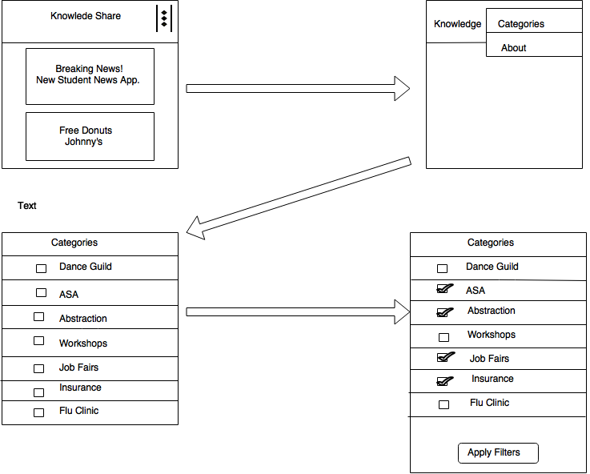
User Interface Model

Slide 9
Deployment Diagram

Slide 10
Database Design

Slide 11
Assessment
Strengths
Simple
Intuitive
Filterable Interface
Potential Improvements
Advanced search feature
A bookmark option
Have a notification system

Slide 12
Questions

